Slide 1


Slide 2
Synopsis
We’ll discuss how to upgrade your code from AX 2012 to Dynamics 365 F&O. We’ll cover the upgrade process inside LCS, the changes for code in Dynamics 365 F&O and the extension model, how to manage your code in Azure DevOps plus integration opportunities that may make moving customizations to the power platform advantageous.​

Slide 3

Nathan Clouse
Technical Architect enVista Corp.
Microsoft Business Applications MVP
nclouse@envistacorp.com
www.atomicax.com
@NathanClouseAX

Slide 4

Sukrut Parab
Senior Architect Hitachi Solutions.
Microsoft Business Applications MVP
sparab@hitachisolutions.com
Sukrut Parab - Microsoft Dynamics Community
@SukrutParab

Slide 5
Topics
Upgrade Process
Prerequisites and considerations
Upgrade analysis
LCS Importance
Code upgrade service in LCS
Code upgrade process –
upgrade considerations
Code upgrade – reports
Extension Development
Extension request with MS
Azure dev ops
Manage code in Azure dev ops
Integration opportunities
Power platform

Slide 6
Overview – Upgrade process
Upgrade paths
Upgrade from AX 2012 R2 and R3 to 10.x
Code and Data Upgrade
Managed through LCS
Code upgrade estimation and execution

Slide 7
Prerequisites
Upgrade is done through LCS
LCS project is Must to start with
Azure dev ops project created to manage process
Connect LCS project to azure dev ops Instance

Slide 8
Key considerations
What to do with ISV Code, Should that be part of upgrade ?
Upside and downside of including ISV model in upgrade process
Get the appropriate version of ISV code
Consider removing unnecessary models from your Model store
Make sure model store you upload is fully compiled

Slide 9
Code upgrade- Analyze
Sign up for LCS
Identify gaps
Create project plan
Select Upgrade methodology
Run upgrade analysis
Run code upgrade tool
Tool : Upgrade process is managed through LCS
Upgrade from AX 2012 R2 and R3 is supported

Slide 10
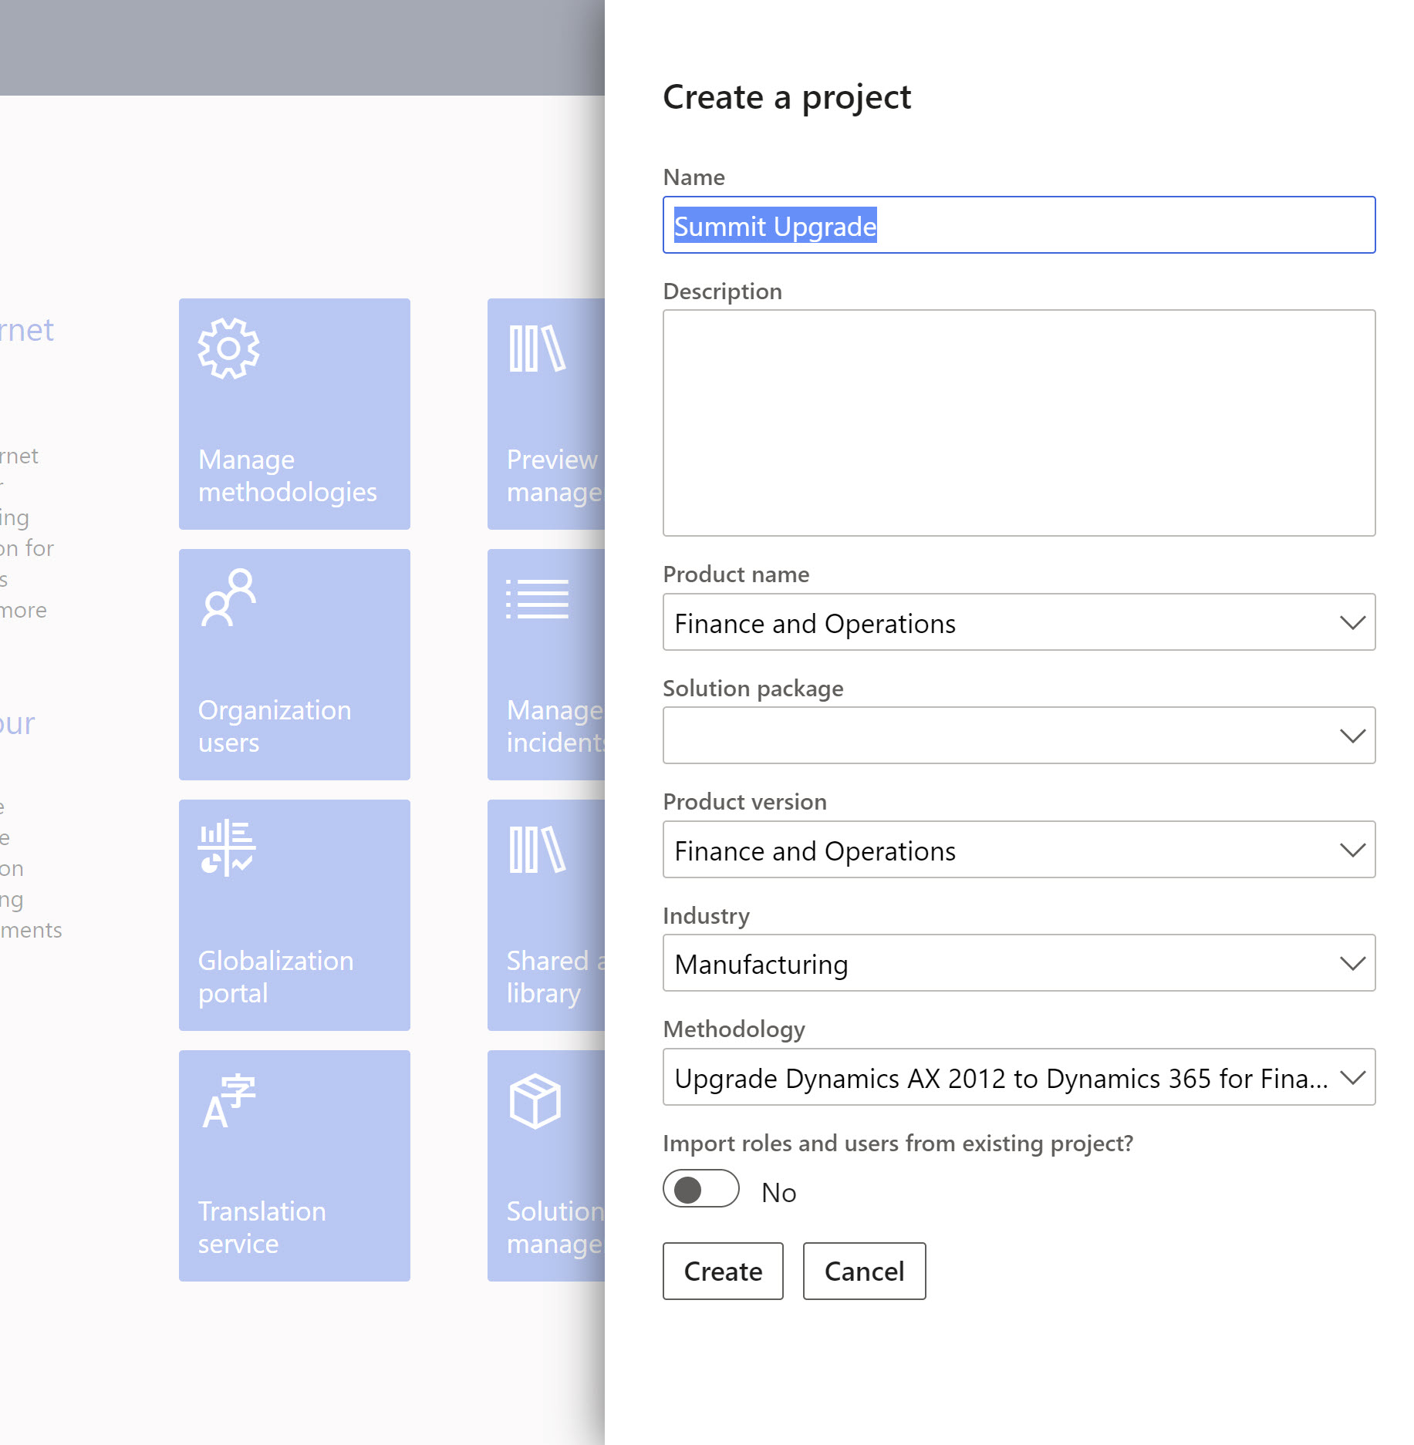
Code Upgrade- Analysis
Project Methodology
Create Project in LCS
Select upgrade AX 2012 to Dynamics 365 methodology

Slide 11
Code Upgrade- Analysis
Run Upgrade Analyzer
Run against Ax 2012 pre-prod environment
Identifies data that you should clean up in AX 2012
Suggests SQL configuration optimizations that can help speed up the upgrade processes
Identifies potential maintenance activities and deprecated features
Results can be viewed from the System diagnostic service in a Microsoft Power BI report in LCS

Slide 12
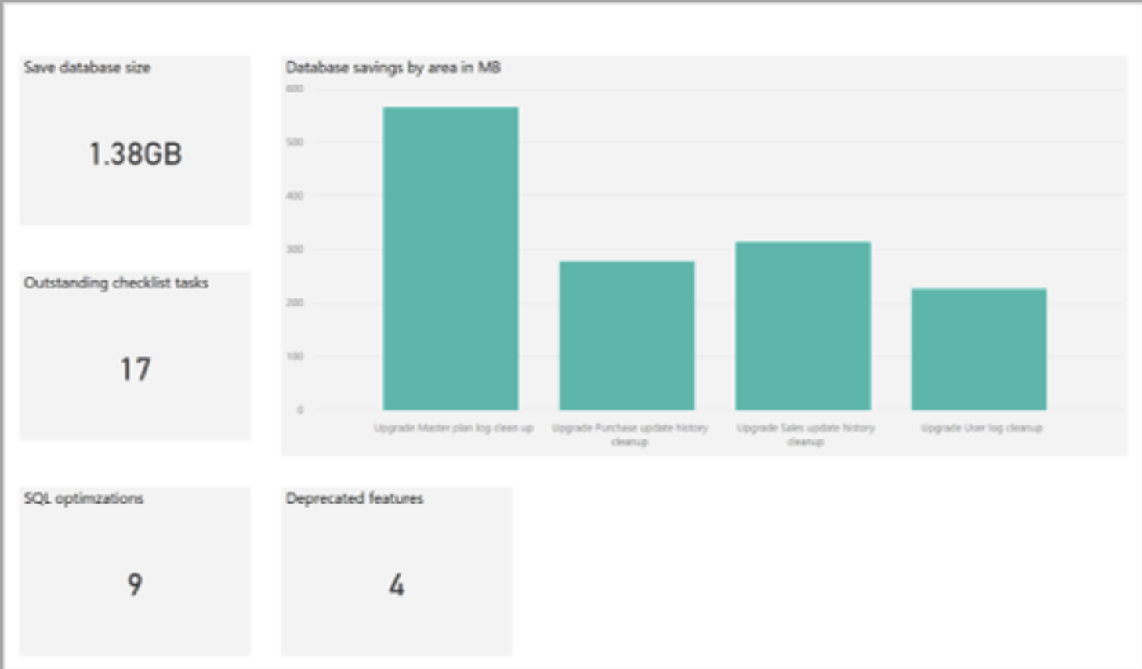
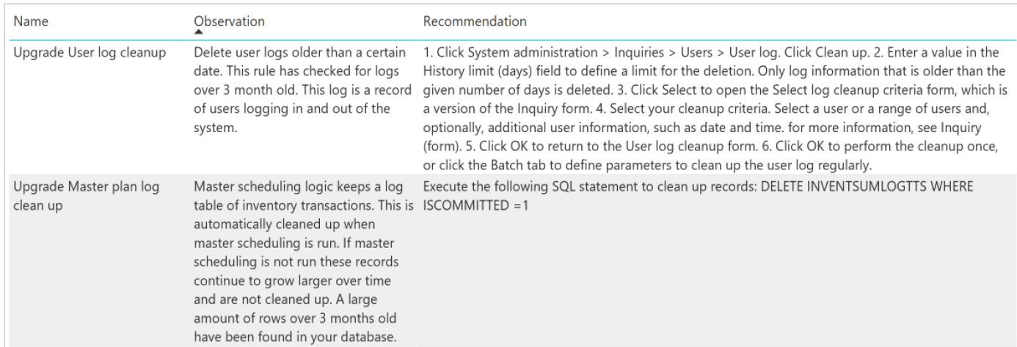
Code Upgrade- Analysis
Report

Slide 13
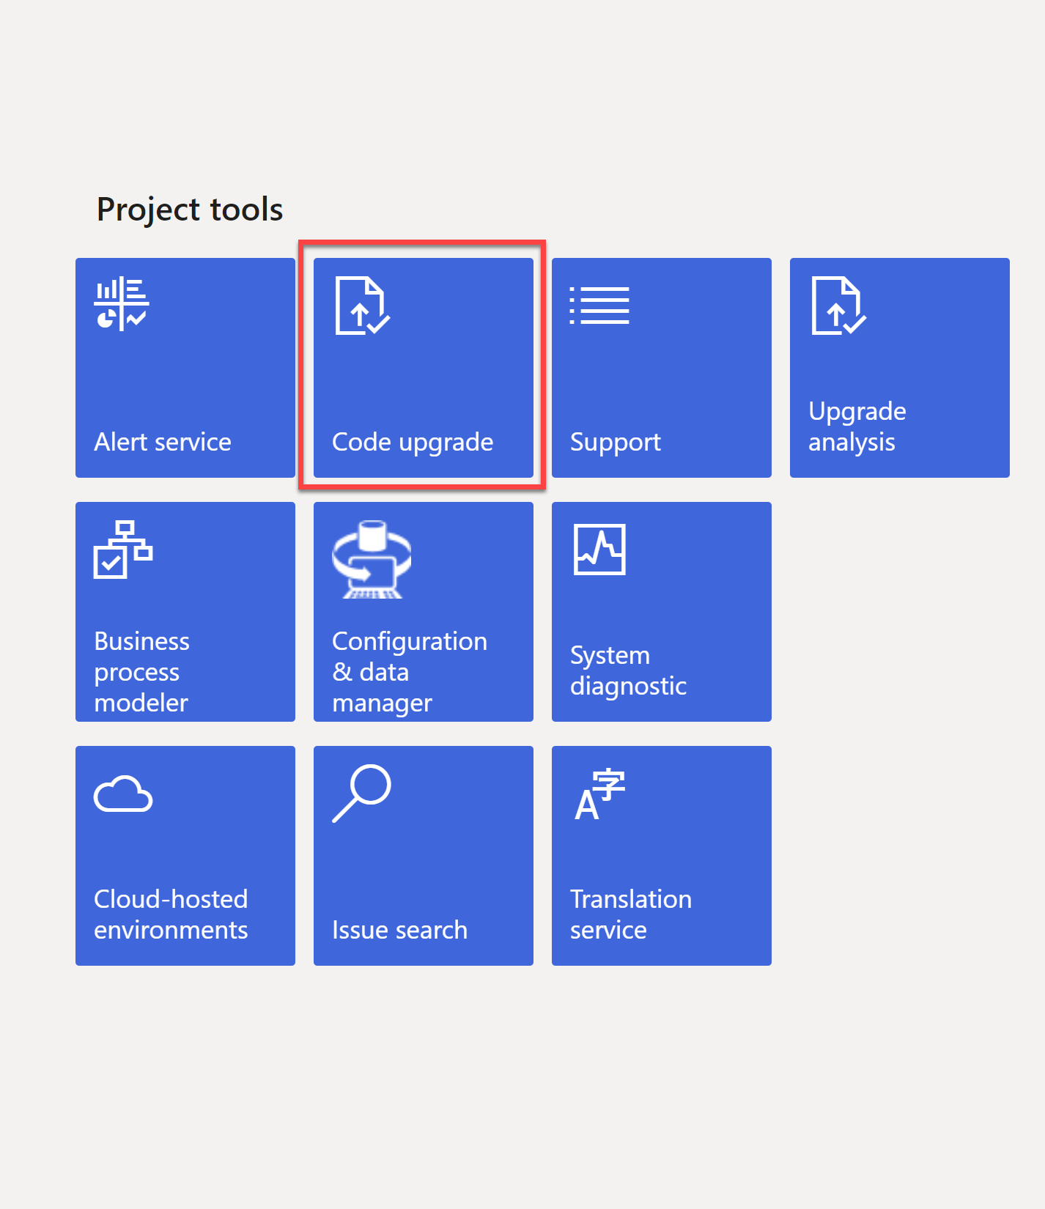
Code Upgrade-Analysis
Run code upgrade service in LCS
Code upgrade service tile in LCS
Upgrades code to finance and operations apps
Code is checked in as overlayered code
Service takes care of most of the over layering related issues
Upgrade efforts can be estimated

Slide 14
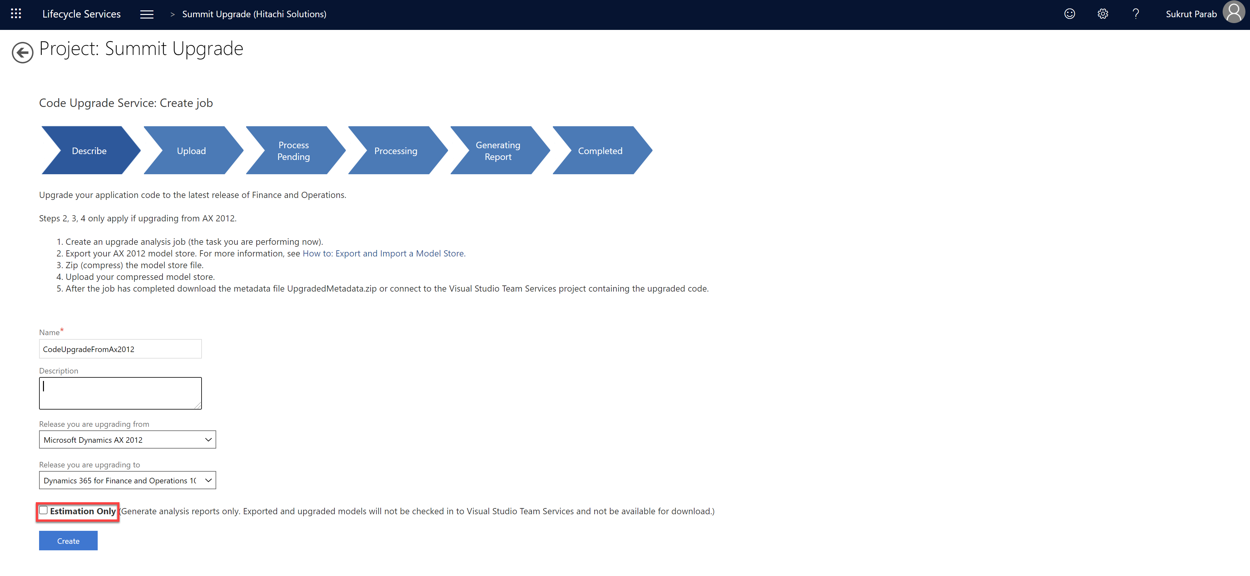
Code Upgrade- Analysis
Create a job in the code upgrade service
For estimation enable “estimation only” check box

Slide 15
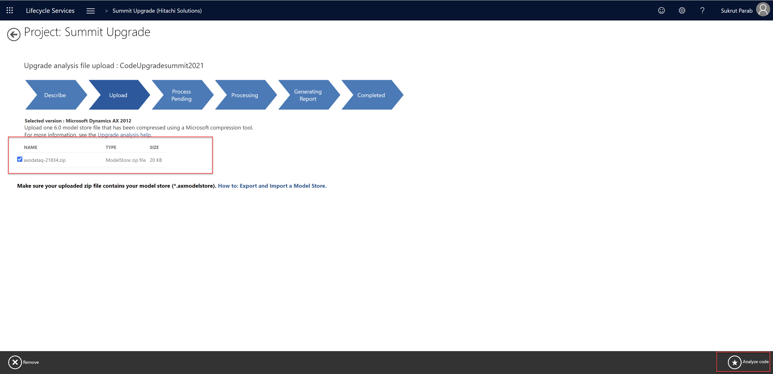
Code Upgrade- Analysis
Select zip file containing model store file
Start code analysis
Review the report

Slide 16
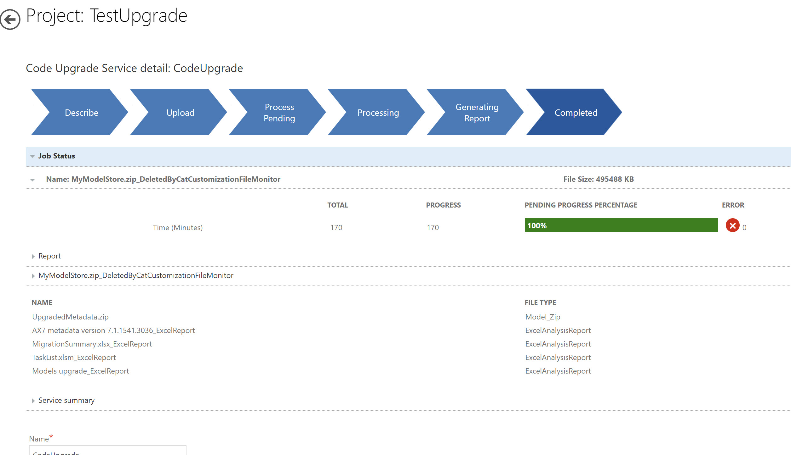
Code Upgrade- Analysis

Slide 17
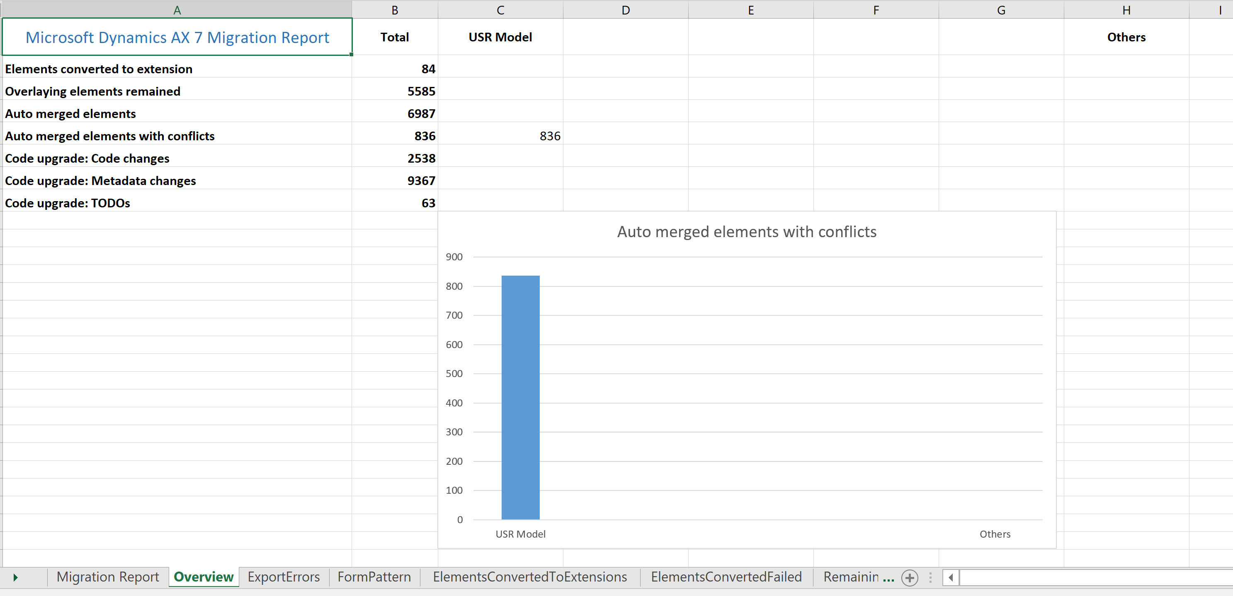
Code Upgrade- Analysis
Summary Report

Slide 18
Code Upgrade- Analysis
Upgraded Code is checked into source control (DevOps)
All upgraded code is overlayered
Work items are created in azure dev ops

Slide 19
Code Upgrade- Analysis
Customization categories
Small – Extension is possible.
Medium – Can be converted to extensions; traversal is required, if needed. You might need to create an extension request.
Large – All report elements are defined as large.
Not in scope – Extension is not possible; traversal is required.
TBD – Unidentified; you will need to define the bucket size.

Slide 20
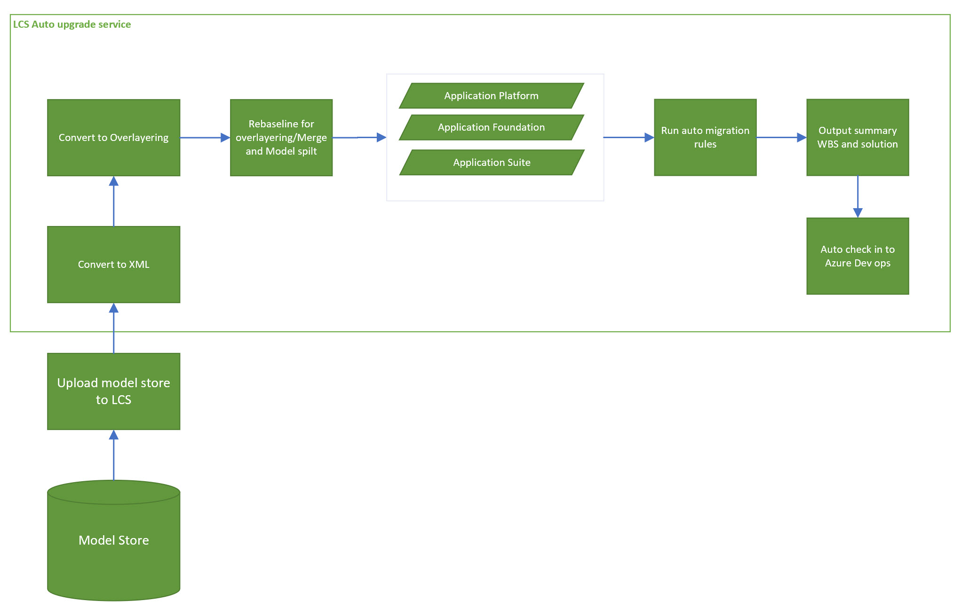
Code Upgrade- Analysis
What happens when we run LCS Service

Slide 21
Code Upgrade- Execution
Create proper branching in Azure dev ops(Dev/Main/Release)
Draft document which has naming conventions, coding standard etc.
Refactor over layering to extensions
Start with lower model (Platform then foundation)and move upwards
Divide tasks within multiple developers
Don’t panic by looking at compile errors
Start with EDT , Enums , tables, views and then move to other objects.
Reports are not upgraded and must be upgraded manually or create extensions.
Complete all task created by upgrade service.
Refactor deprecated features(Integrations designed using AIF, File based integrations etc.)

Slide 22
Extensions

Slide 23
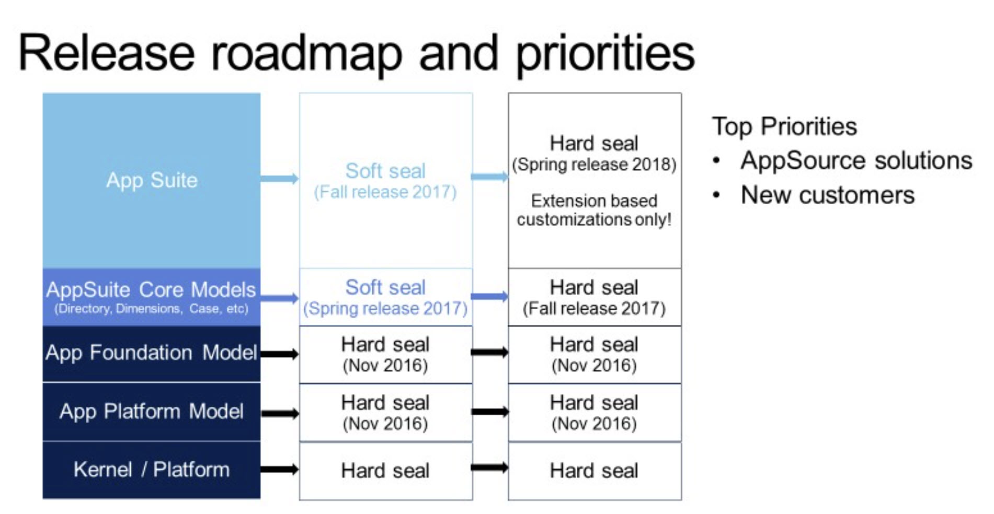
Development using extension’s approach
Models are sealed for over layering

Slide 24
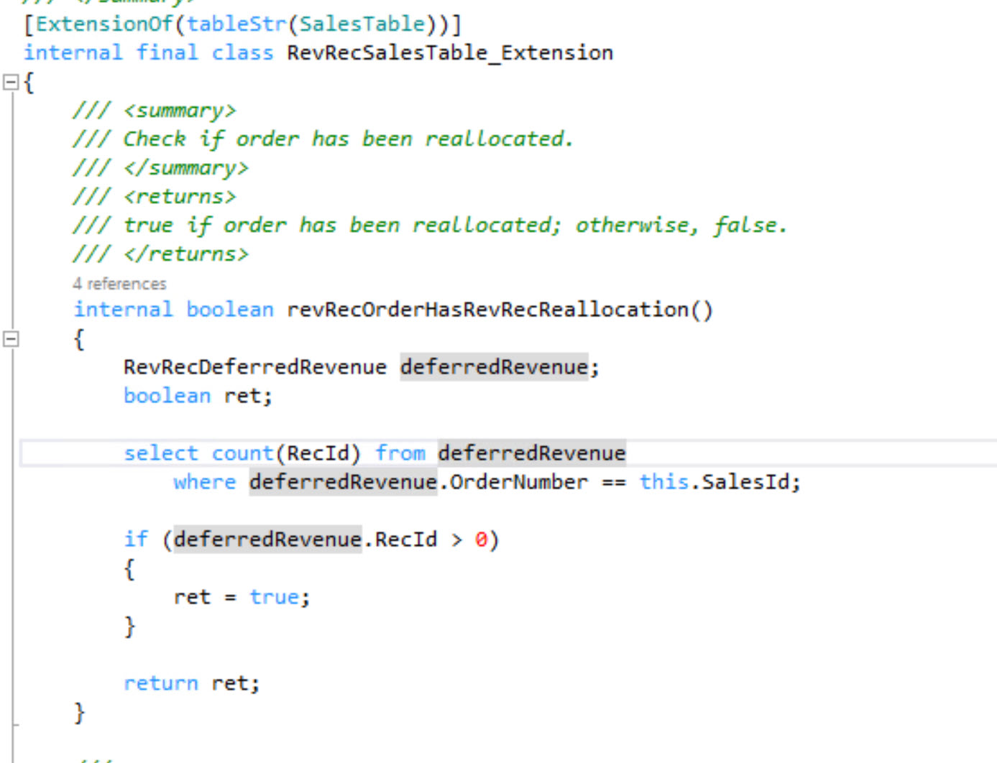
Development using extension’s approach
Code Extension Types
Events (Pre /Post)
Delegates
Chain of command(COC)
Widely used

Slide 25
Development using extension’s approach
Chain Of command
You can wrap base public or protected methods
Access to protected members from extension classes

Slide 26
Development using extension’s approach
Extensibility Requests
Extensions is the only way to add on top of what comes with standard offering
Some customizations which are possible with over layering can not be accomplished using extensions
If you encounter a situation where extension is not possible, log extensibility request from LCS.

Slide 27
References
Analyze code upgrade
Configure code upgrade
Environment planning
Develop using extensions
Extensibility request

Slide 28
Azure Dev Ops

Slide 29
Integration opportunities and Power platform

